Slide 1
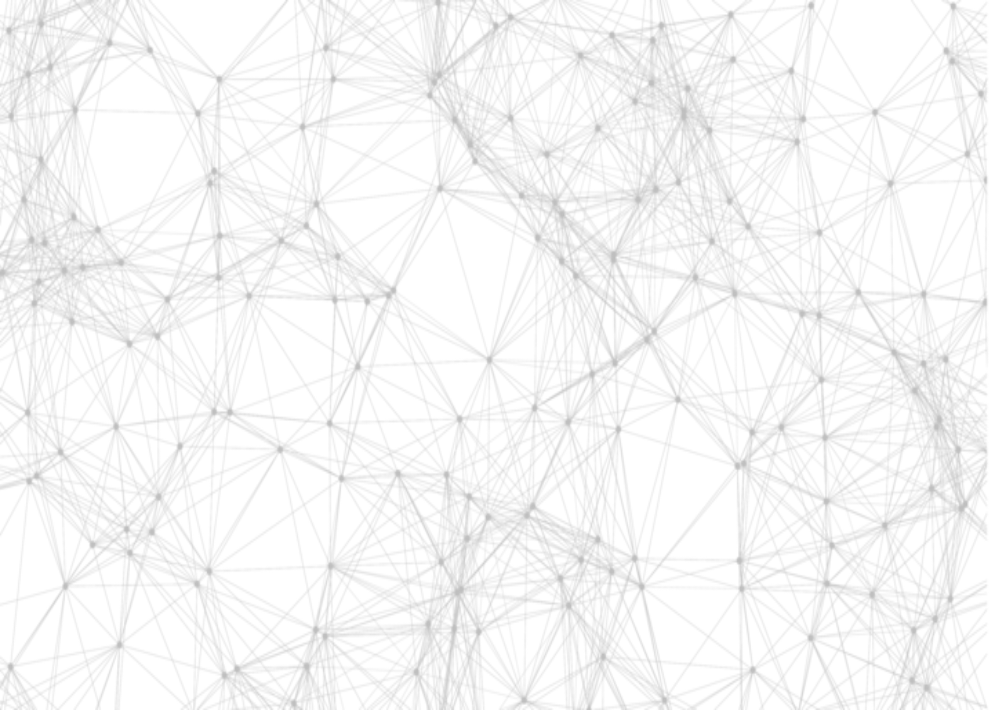

Decision Making Under Uncertainty: A Primer
Computational Intelligence for Integrated Design (AR0202) [2023/24 Q3]
Prateek Bhustali
PhD student, AiDAPT
April 03, 2024

Slide 2
Contents
Markov Decision Processes
Planning: Value Iteration
Reinforcement Learning: Q-Learning
Application: Inspection & Maintenance planning

Slide 3
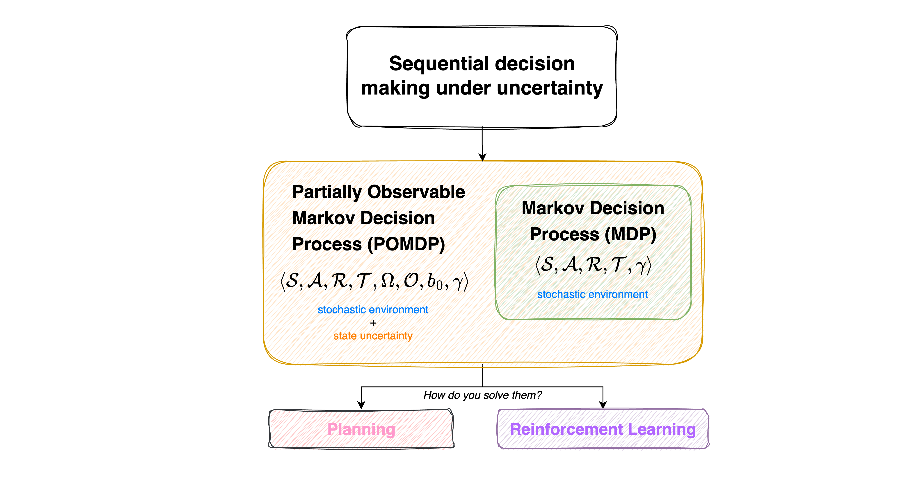
Overview

Slide 4
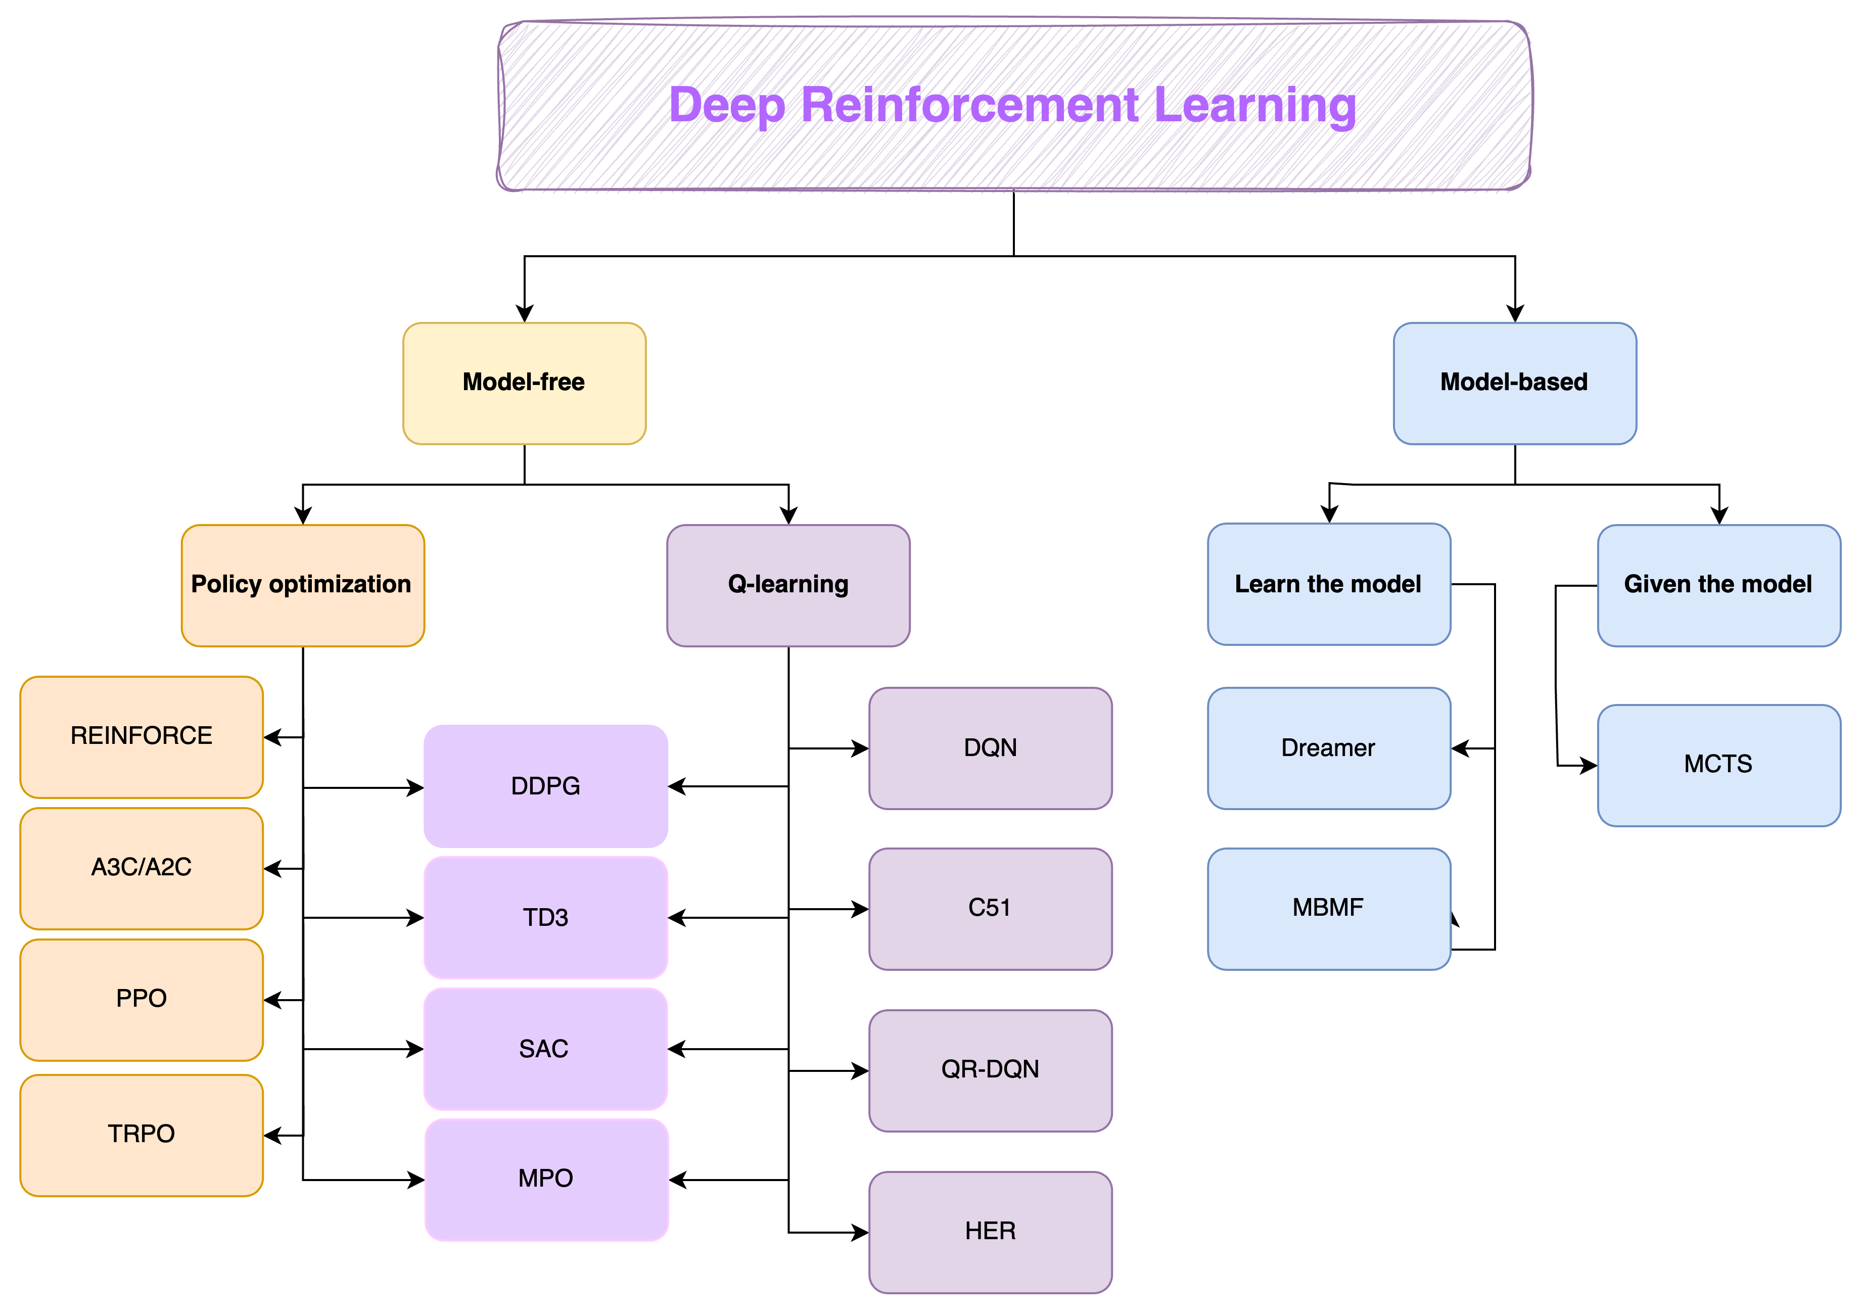
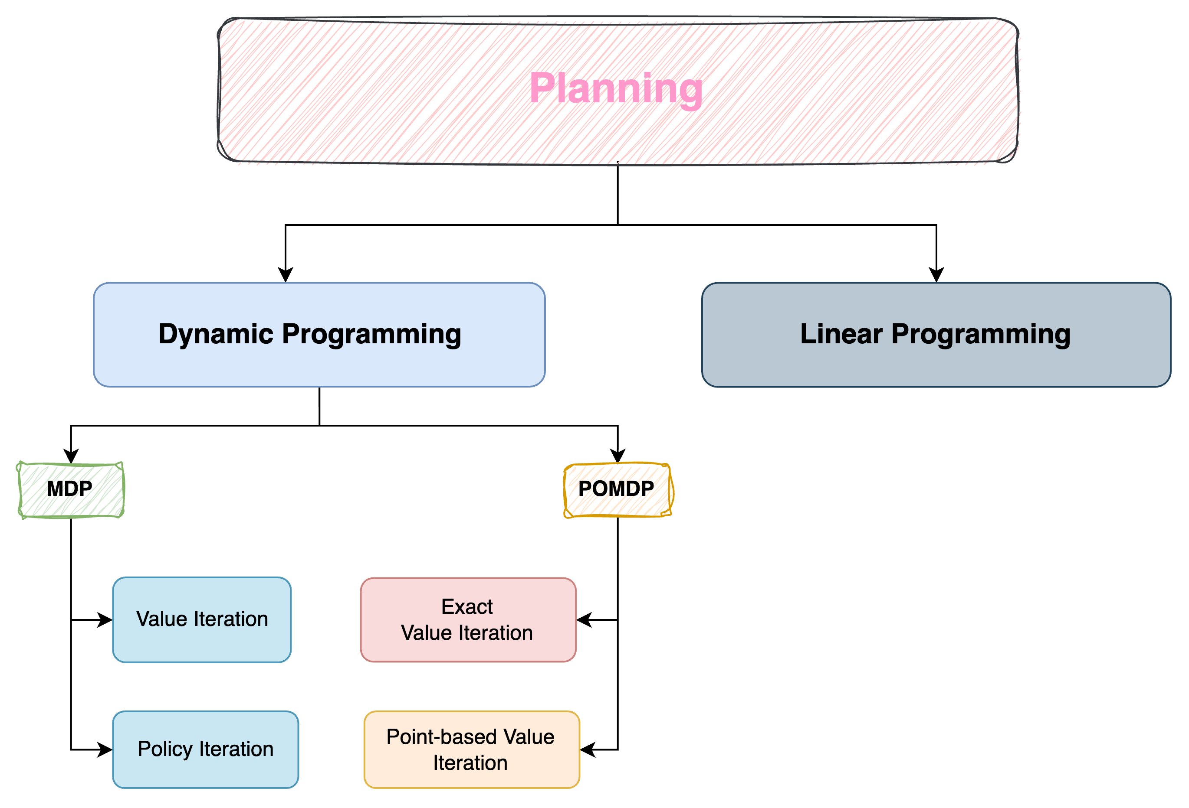
How do we solve them?

Slide 5

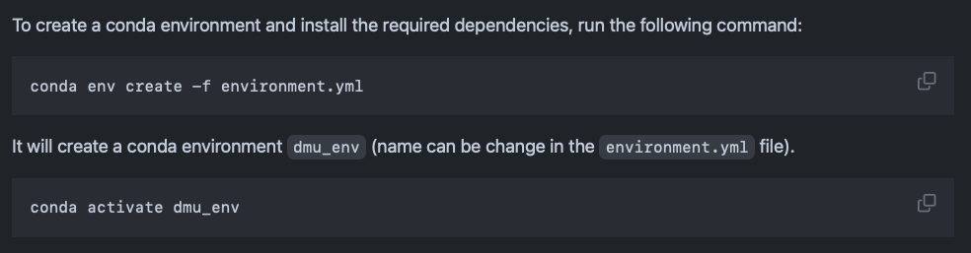
Please setup your Jupyter Notebooks ☺
Clone/download the repository: https://github.com/omniscientoctopus/decision_making_primer
Navigate to the folder in your terminal (`cd <repository-location>`)
Install conda environment (installs necessary packages)
Open the notebook: `1_Markov_Decision_Process.ipynb`
https://github.com/omniscientoctopus/decision_making_primer

